Slide 1


Final Year Project Work Proposal Defense
On
Xplitter: Expense Splitter
Presented by
Namkonghang Kirat (7329/072)
Neha Adhikari (7330/072)
Ruxana Maharjan (7342/072)
Srijal K.C. (7348/072)
B.Sc. CSIT IV/I (2072)
March, 2019

Slide 2
Presentation Outline
About Project
Literature Review
Methodology
System Analysis
Time Scheduling
Expected Results

Slide 3
About Project
Problem Statement
Splitting bills is tedious
Miscalculation
Transparency

Slide 4
Objective
To help in splitting bills and expenses among a group of people.
To keep a proper track of who owes how much to whom.

Slide 5
Literature Review
Only for expense calculation and splitting purpose.
Multi-user syncable applications.
Earlier
Notification and Verification.
Adding reference Image in every transaction.
Report generation
Xplitter

Slide 6
Methodology
Resource Requirements
Software
minimum version - 5.0 (Lollipop)
Hardware
memory (RAM)
chipset(CPU, GPU)
Wi-Fi
(No need of sensors, GPS)

Slide 7
Methodology (Continued)
Process Model
Agile Process Model
Process adoptability and Customer satisfaction
Fast
Flexible
Tools and Techniques
IDE: Android Studio
Back-end Tool: Java
Front-end Tool: XML
Other tools : MS-Visio

Slide 8
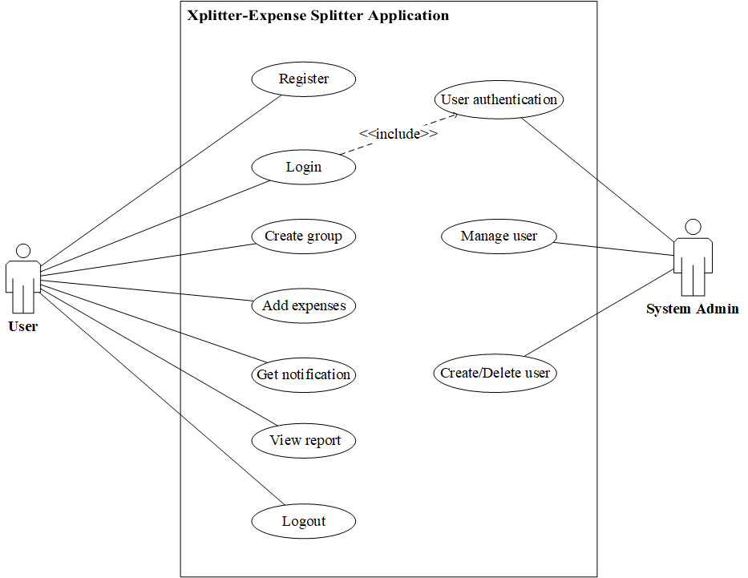
System Analysis
Functional Requirements (Use Case Diagram)
Notes:
· We did system analysis in order to completely understand the application that we are going to create.
· The gathered information will help us create logical models so that we can code our application to satisfy our goals.
· We broke large complex project into small manageable parts so each may be designed, studied and analyzed in detail.
· We used tools that will help us to transform requirement specification into implementation
· We have used UML as visual modeling language.
· Some of the tools that we used are Use case diagram for analyzing functional requirement, ER diagram for data modeling technique and Context diagram for process modeling
Use case diagram for analyzing functional requirement
· We can see it is providing concise summary of what our app should do at abstract level.
· The expected behavior of our app has been specified.
· Here, Xplitter-Expense Splitter Application is an app we are going to develop.
· User and system admin are actor that will use the app.
· These are list of use cases that captures the requirements that the actors want to achieve.
· User being in the left is the primary actor who initiates the use of the app.
· System admin being at right is our secondary actor who reacts only when user does something like here when user login, system admin authenticates.

Slide 9
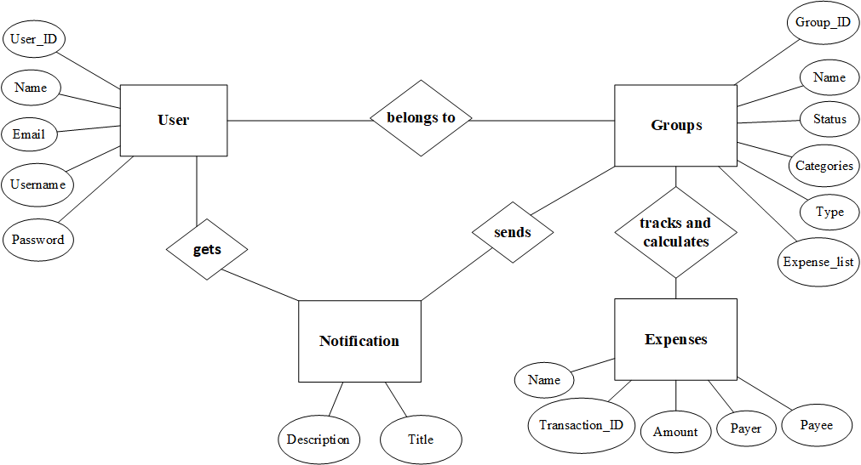
System Analysis (Continued)
Data Modeling Technique (ER Diagram)
Notes:
· We have used Chen’s Notation
· Constructing ER diagram helped us to visualize our database for our App.
· Here we can see entities are user, groups, expenses and notification which will be the tables that we will make in database in order to store data.
· Their attributes are the properties that will describe the entities i.e. the columns of table that we need to describe each tables and relationship between entities are showing how these entities or tables in database will be linked together.
· Here User is one table in database that holds information of Users and columns of this table will be User_ID, Name, etc.
· This table is linked with another table Groups and Notification.

Slide 10
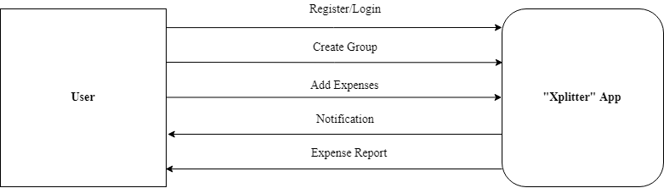
System Analysis (Continued)
Process Modeling (Context Diagram)
Notes:
· Here we have used Gane Sarson notation for drawing Context Diagram.
· This context diagram is showing the overview of our App i.e. the expected input and output of our App.
· Here, the external entity User will receive information from app and also contribute into the app.
· Using this context diagram we have modeled the expected data that will go into our App the after it is processed by the app, what will be returned to the external entity.
· So here, User is our external entity who will input data for registration, login, creating group or joining group. After these entered data is processed by our App, the expense report and the notification is returned to the User.

Slide 11
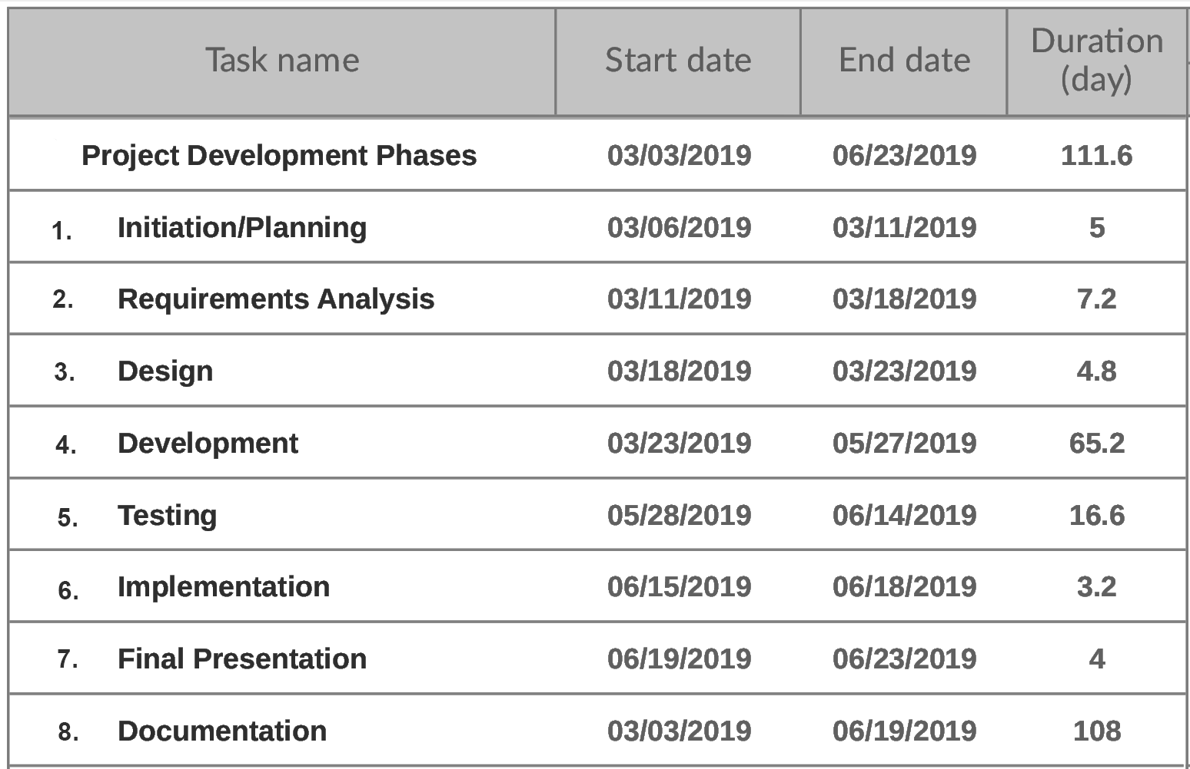
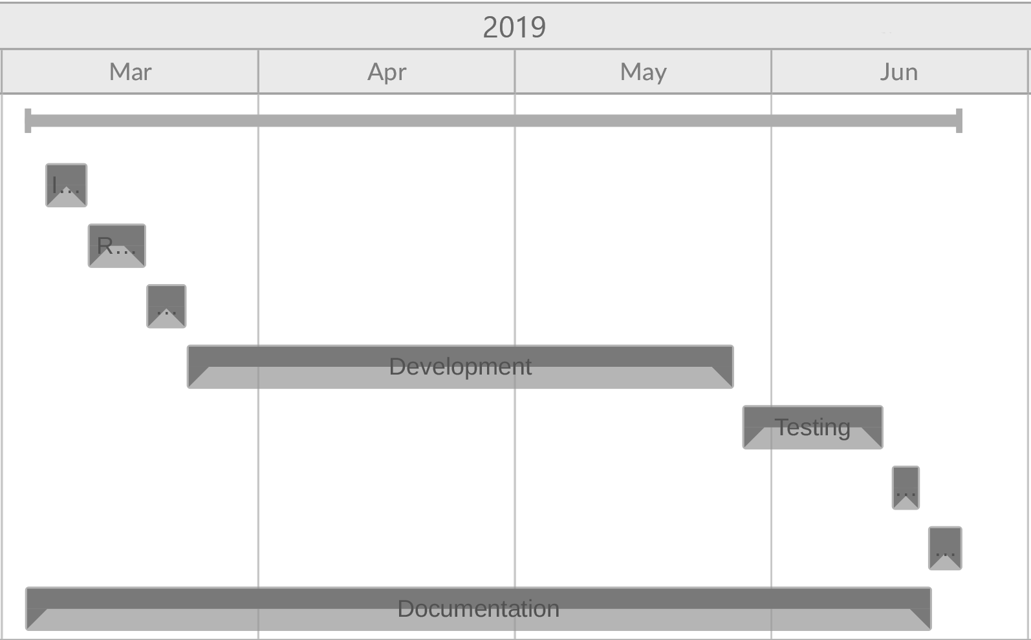
Time Scheduling

Slide 12
Expected Results
Registration, login then create or join groups.
Input transactions in the group, and verify it.
Application will notify and alert the users on new transactions added.
Compute the input data and provide the users with a fairly split amount.

Slide 13
Thank You

